Slide 1
Review of Autumn Quarter

Slide 2
About myself
3rd year, math spec econ + econ major
Interested in applied micro + metrics + spatial economics
Feel free to ask me about:
Interesting economics questions (to discuss together)
The economics major + economics course selection
How to find economics research on campus

Slide 3
Plans for Winter Quarter
Review material in Autumn quarter
Github
Latex 101
More on tidyverse + ggplot2 in R
Instrumental variables
Diff-in-diff (if we have time)

Slide 4


Solving the econometrics question
World of Potential Outcomes
Sample
ATE
Casual Relationship
Sample statistics
Identification
Statistical inference
$$μ$$
Population
$$\hat{μ}$$
Population statistics

Slide 5

Linear regression
$Y= β_{0}+ β_{1}X+U$
Notes:
During linear regression we then nail down the two betas by the following equation

Slide 6

Linear regression
$Y= β_{0}+ β_{1}X+U$
$E\left[U\right]=0, E\left[UX\right]=0$
Notes:
Y, X, U here are all random variables, with U being defined by Y and X. Not this is statistical, that is the two betas can be anything
Not, here we are using expectations, that is we are talking about the population, and not inference
Why these assumptions? E[U] is simple, we want the fitted model to have an average error of 0
E[UX] is more complex, what this implies is Cov[UX] = E[UX] – E[U] E[X] = 0. So U and X are not linearly correlated

Slide 7

Linear regression
$Y= β_{0}+ β_{1}X+U$
$E\left[U\right]=0, E\left[UX\right]=0$
Solution: $β= \frac{Cov(Y, X)}{Var(X)}$
Notes:
So basically we get how much Y and X vary together over how much X vary.
Why is Var of X below: lets think of a line, what happen of X is stretched while X, Y remains the same, while the slope drops

Slide 8

Linear regression
$Y= β_{0}+ β_{1}X+U$
$E\left[U\right]=0, E\left[UX\right]=0$
Solution: $β= \frac{Cov(Y, X)}{Var(X)}$
OLS: minimize $E[U^{2}]$
Notes:
Now, you may say how does this relate to the normal OLS estimator
Okay lets try to solve the question of OLS, you will see the first order conditions are exactly the assumptions above. So this is in fact the same problem.
Alternatively, we can say this is a projection onto the vector space of X, what is left is the part diagonal to Y. This might be not that easy to see in 2D, but ones we draw this in 3D everything is very clear. The key is to see the beta_0 not as a separate intercept, but as a different dimension
This is all slightly abstract, but ones you get into metrics, you need to get accustomed to thinking with vectors and matrixes, because that is more workable than lots of equations

Slide 9
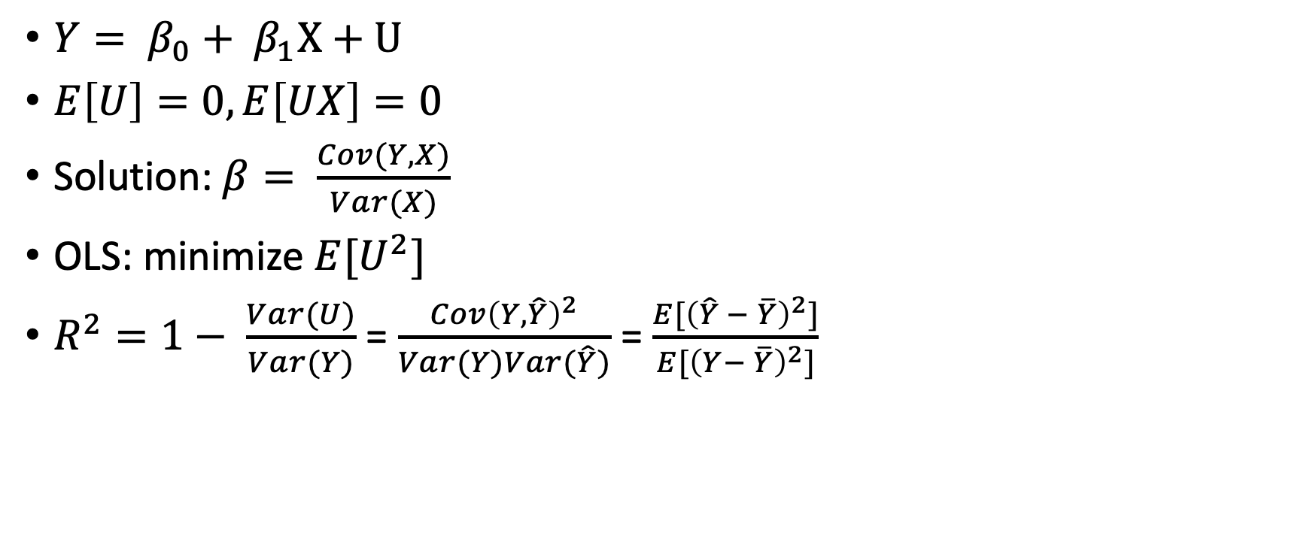
Linear regression
$Y= β_{0}+ β_{1}X+U$
$E\left[U\right]=0, E\left[UX\right]=0$
Solution: $β= \frac{Cov(Y, X)}{Var(X)}$
OLS: minimize $E[U^{2}]$
$R^{2}=1− \frac{Var(U)}{Var(Y)}$ = $\frac{Cov{\left(Y,\hat{Y}\right)}^{2}}{Var(Y)Var(\hat{Y})}$ = $\frac{E[{\left(\hat{Y} − \overline{Y}\right)}^{2}]}{E[{\left(Y− \overline{Y}\right)}^{2}]}$
Notes:
Now, lets set that aside and consider a different question. When we are looking at models, we are often considered with a variable called R^2
I am not going to how this is calculated, but R^2 measures how good the fit is. The larger the R^2, the better the fit. It can also be seen as the squared correlation between Y and fitted Y.
Or alternatively, as the percentage of variation of the data that is covered by the model.
Please note, in linear regression, R^2 is always smaller than 1

Slide 10

Linear regression (Sample)
$y_{i}= β_{0}+ {β_{1}x}_{i}+u_{i}$
Recall: $\frac{1}{N}$ $\sum_{i=1}^{N}{x_{i}}$ $\underset{→}{p}$ $E\left[X\right]$by WLLN if Var(X) < infinity
OLS: minimize$\frac{1}{N}\sum_{i=1}^{N}{{\left(y_{i}−x_{i}\right)}^{2}}$
$R^{2}=\frac{ESS}{TSS}$
Notes:
Now lets think of inference within the sample. Recall how we can use the plug in principle. – sample analogues to population stats. This uses the weak law of large numbers. We also need a few more theorems to prove this is true in the multivariate case. It is sufficient for now to know that the plug in principle works for the general steps of linear regression and we can directly define the inference sample stats from the population ones.

Slide 11
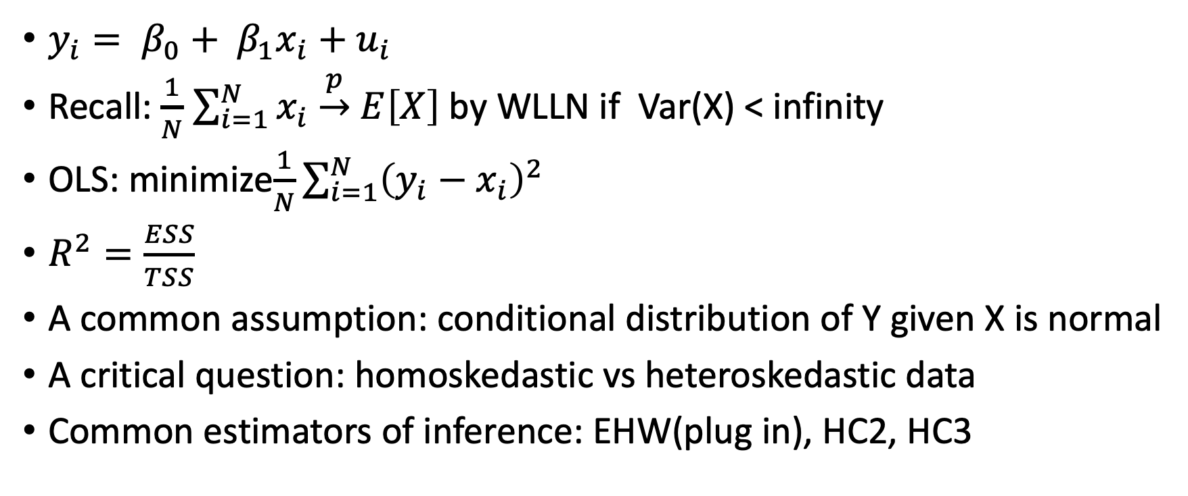
Linear regression (Sample)
$y_{i}= β_{0}+ {β_{1}x}_{i}+u_{i}$
Recall: $\frac{1}{N}$ $\sum_{i=1}^{N}{x_{i}}$ $\underset{→}{p}$ $E\left[X\right]$by WLLN if Var(X) < infinity
OLS: minimize$\frac{1}{N}\sum_{i=1}^{N}{{\left(y_{i}−x_{i}\right)}^{2}}$
$R^{2}=\frac{ESS}{TSS}$
A common assumption: conditional distribution of Y given X is normal
A critical question: homoskedastic vs heteroskedastic data
Common estimators of inference: EHW(plug in), HC2, HC3
Notes:
One common assumption is normality. This is useful for inference on beta. What this is useful is in estimating the standard error. We would not go into the details of how the estimators of standard error is constructed, since R and stata do a good drop of calculating these stats. But lets talk in general about the categories and why it is important, since it is highly important in how we can interpret linear regressions.
This is of course not the only way we can do inference, since we can also do this asymptotically
All of this matter if we want to construct the estimator for the variance of beta, which we are not going into details here.
A crucial question to consider: homo vs hetereskasdatic error.
HC3< HC2 < EHW, more conservative estimates, usually: HC2 or HC3 if hereoskedastic

Slide 12
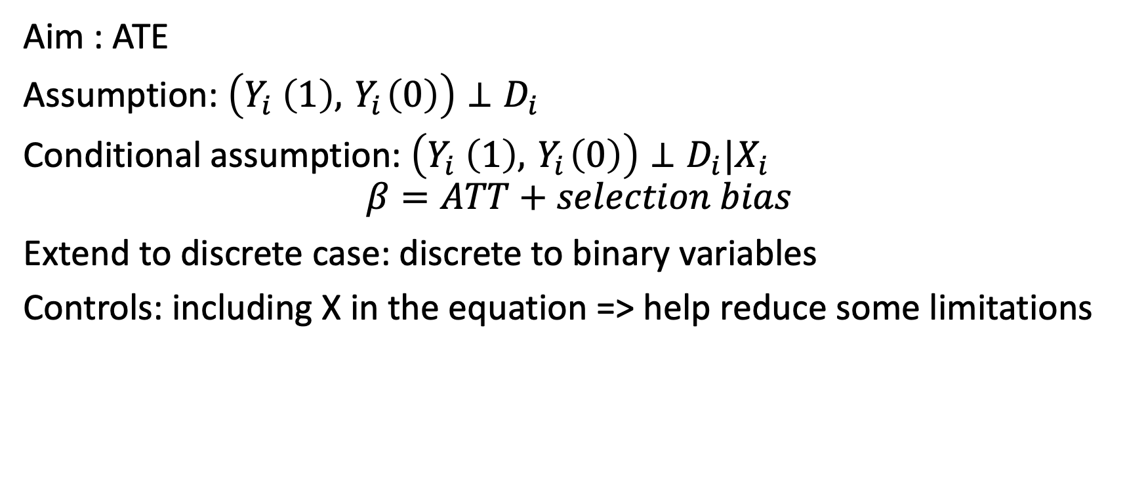
Establishing causality
Aim : ATE
Assumption: $\left(Y_{i} \left(1\right),{ Y}_{i}\left(0\right)\right)⊥D_{i}$
Conditional assumption: $\left(Y_{i} \left(1\right),{ Y}_{i}\left(0\right)\right)⊥D_{i}|X_{i}$
$$β=ATT+selection bias$$
Extend to discrete case: discrete to binary variables
Controls: including X in the equation => help reduce some limitations
Notes:
Now lets think about roughly (not mathematically) how we want to extend all of these to the general continuous case. We still want to assume that D’s affect on Y is the same at each level of D and we want to know on average how much increasing a unit of D would help. This would mean in fact that structural residuals is uncorrelated with treatment. That is other factors that generate Y should not be correlated with the treatment.
Give the example of summer, drowning and ice-cream as an example of when this break.

Slide 13
Some key things to consider in real application
Omitted variables
Measurement error
Reverse causality
Self selection

